Slide 1


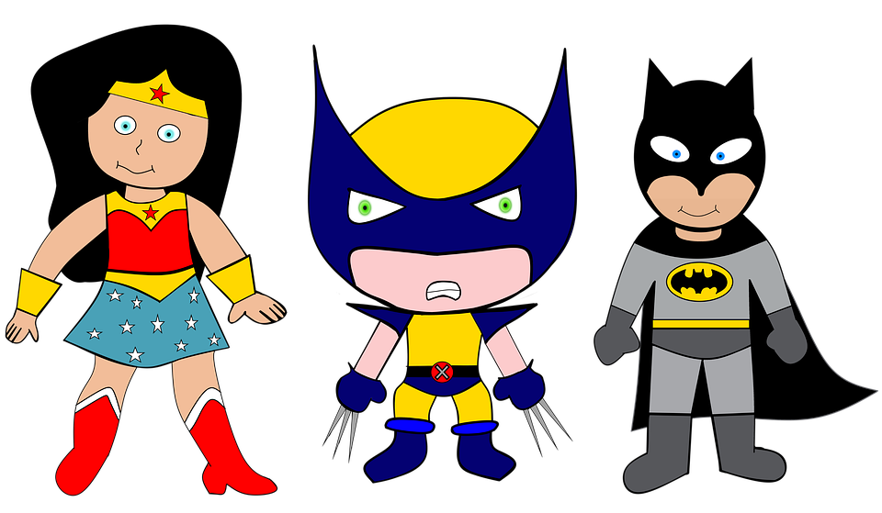

We are SUPERheroes!
Students Using their Powers to Engage in Reading!
Kindergarten Newsletter – November 8-12, 2021
IMPORTANT EVENTS
Breakfast ends at 7:25!
11/11 | Star Test Week Progress Reports
The EXPERT in anything was once a BEGINNER!
HOMEWORK
Mon. – Thurs. | Weekly ELA Sheet Math HW Pages Practice Sight Words List Read 10 minutes per night
WEEKLY ASSESSMENTS
ELA | Module 3.4 test Spelling test (at,sat,am) Study Lowercase letters Vowels and Onset/Rime Test
Math | Lesson 13 test
ART NEWS
Some of the students are coloring a fall picture in art. It is a contest paper for Speedee Cash. It is optional. Parents, you will be responsible for taking the paper to Speedee Cash for them to enter.
WEEKLY MATH SKILLS
2D shapes/Positional words Writing 1,2,3,4,5,6,7,8,9,10 More and Less Decompose numbers 3-10
REMINDERS
Please make sure all money is sent in your child’s blue folder labeled and sealed. If your child is absent, please send an excuse labeled with the following information: Child’s name, date of absence, teacher’s name, and reason for absence.
SCHOOL SAFETY
Be sure your child wears a mask to school DAILY!

Slide 2
Module 3 Week 4: My Community Heros
LEARNING MINDSET: Belonging
ESSENTIAL QUESTION
What makes a community?
PHONICS
Introduce Letters: S/s/ and s /z/ verbs -ip word family
READING
Genre: Fiction Story Elements: Characters, Settings, Events Informational Texts | Listening Comprehension Parts of a Book Collaborative discussions
WORDS TO KNOW
Sits Me With
VOCABULARY
BIG IDEA WORDS: community, location, neighbor POWER WORDS: brave, expect, ordinary Books: A Piece of Home and Welcome
REVIEW
Letters and sounds Aa-Ff Gg-Pp Qq-Zz
WRITING
Nouns and Verbs Characters/Setting Narratives
SPELLING WORDS
At Sat am
PHONEMIC AWARENESS
Identify Rhymes Identify Syllables Beg., Medial, Final Sounds

